Slide 1
STACK

Slide 2
Roadmap …
Data type
Abstract Data Type(ADT)
Stack Data Structure
Stack ADT
Postfix evaluation algorithm and code using Stack ADT
Algorithm and code for Evaluation of Infix expression

Slide 3
Recall…..
The way to write arithmetic expression is known as a notation. An arithmetic expression can be written in three different but equivalent notations, i.e., without changing the essence or output of an expression. These notations are −
Infix Notation
Prefix (Polish) Notation
Postfix (Reverse-Polish) Notation
These notations are named as how they use operator in expression.

Slide 4
Data Type
Data type is most primitive classification of data. It represents its Storage, Interpretation, Operations.
Every single value is an entity.
Eg:
int num = 0;
4 Bytes ( as defined by the complier)
Interpretation : 2’s Complement rep / (float)IEEE standards 754
Operations: + - * / % >>,<< etc
Num = Num *10 + dig

Slide 5
data structure
A data structure is a set of data considered as one entity (thing).
Eg: Array, linked list, stack, queue etc
It is a collection of data types. It is a collection of organizing the items in terms of memory and also the way of accessing each item through some defined logic.

Slide 6
abstract data type
An abstract data type is a mathematical model of a data structure and operations on them. In other words, an ADT is an interface to what a DS is the implementation.

Slide 7
Operations
Int x,y,z;
X= y*z;
What? KNOWN
How? UNKNOWN (abstract)

Slide 8
Stack ADT
Collection of elements with two principal operations :
push, which adds an element to the collection, and
pop, which removes the most recently added element that was not yet removed.
Stack is a Last in First Out list

Slide 9
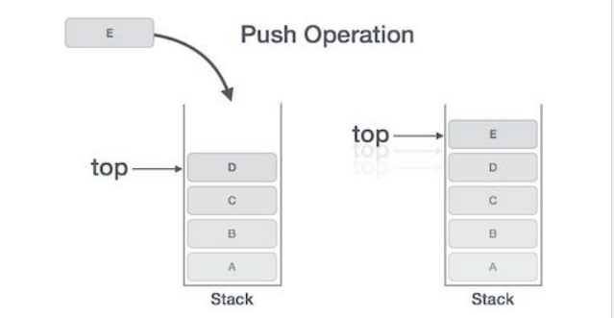

Slide 10
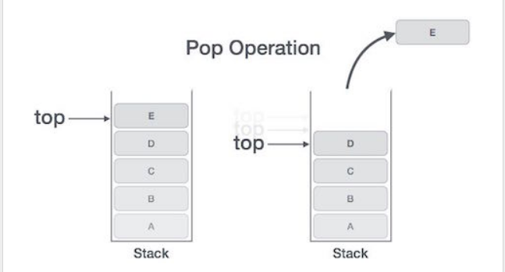

Slide 11
Last In First Out
B
A
C
B
A
B
A
D
B
A
A
top
top
top
top
A
top
push A
push B
push C
x = pop()
push D
x = pop()
x = pop()
??
x = pop()
x = pop()

Slide 12
Stack ADT (extension)
Collection of elements with the operations:
Push(element)
Element pop()
Bool isempty()
Bool isfull()
Element peek()
Initialize()

Slide 13
void push(stack *s, int x) {
s->a[s->i++] = x;
}
#define MAX 32
typedef struct stack {
int a[MAX];
int i;
}stack;
void init(stack *s) {
s->i = 0;
}
/* the caller should check
* isempty() before
* calling pop()..
*/
int pop(stack *s) {
int temp;
temp = s->a[s->i - 1];
s->i--;
return temp;
}
int isfull(stack *s) {
return s->i == MAX;
}
int isempty(stack *s) {
return s->i == 0;
}

Slide 14
Postfix() revisited..
a[i-2] =(res);
i--;
}
else if(t.type == END) {
break;
}
else if(t.type == ERROR) {
return INT_MIN;
}
}
if(i == 1)
return a[0];
else
return INT_MIN;
}
switch(t.data.op) {
case '+':
res = x + y;
break;
case '-':
res = x –y ;
break;
case '*':
res = x* y;
break;
case '/':
res = x/ y;
break;
case '%':
res = x% y;
break;
}
int postfix(char *str) {
int a[32];
int i = 0;
int x, y, res;
token t;
while(1) {
t = getnext(str);
if(t.type == OPERAND) {
a[i++] = t.data.num;
}
else if(t.type == OPERATOR) {
x = a[i - 2];
y = a[i - 1];

Slide 15
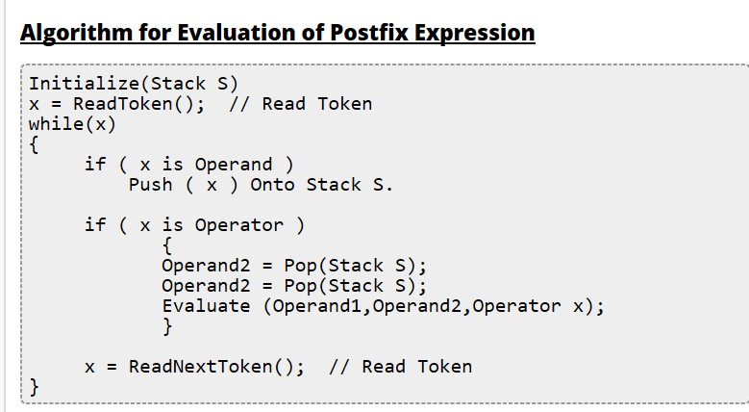

Slide 16
postfix() (modified)
int postfix(char *str) {
int x, y, res;
token t;
stack s;
init(&s);

Slide 17
while(1) {
t = getnext(str);
printf("t.type = %d t.num = %d t.op = %c\n",
t.type, t.data.num, t.data.op);
if(t.type == OPERAND) {
if(!isfull(&s))
push(&s, t.data.num);
else
return INT_MIN;
}

Slide 18
else if(t.type == OPERATOR) {
if(!isempty(&s))
x = pop(&s);
else
return INT_MIN;
if(!isempty(&s))
y = pop(&s);
else
return INT_MIN;

Slide 19
switch(t.data.op) {
case '+':
res = y + x;
break;
case '-':
res = y - x;
break;
case '*':
res = y * x;
break;
case '/':
res = y / x;
break;
case '%':
res = y % x;
break;
}

Slide 20
if(!isfull(&s))
push(&s, res);
else
return INT_MIN;
}
else if (t.type == END) {
break;
}
else if(t.type == ERROR) {
return INT_MIN;
}
}
if(!isempty(&s))
res = pop(&s);
else
return INT_MIN;
if(isempty(&s))
return res;
else
return INT_MIN;
}

Slide 21
ADT STACK

Slide 22
Postfix.c
#include “stack.h”
Compile
Link postfix.o and stack.o and run
“Stack.h”
#define MAX 32
typedef struct stack {
int a[MAX];
int i;
}stack;
int isempty(stack *);
int isfull(stack *);
void init(stack *);
Int pop(stack *);
void push(stack *, int );
“stack.c”
#include “stack.h”
Code for all stack functions
Compile partially

Slide 23
Postfix.c
#include “Stack.h”
Compile
Link postfix.o and stack.o and run
**Usage**
“Stack.h”
#define MAX 32
typedef struct stack {
int a[MAX];
int i;
}stack;
int isempty(stack *);
int isfull(stack *);
void init(stack *);
Int pop(stack *);
void push(stack *, int );
**Interface**
“stack.c”
#include “stack.h”
Code for all stack functions
Compile partially
**Implementation**

Slide 24
cc –c postfix.c
cc –c stack.c
cc postfix.o stack.o

Slide 25
Evaluation of infix expression
getline()
getnext()
infixtopostfix()
postfix()
main()

Slide 26
Let, X is an arithmetic expression written in infix notation. This algorithm finds the equivalent postfix expression Y.
Push “(“onto Stack, and add “)” to the end of X.
Scan X from left to right and repeat Step 3 to 6 for each element of X until the Stack is empty.
If an operand is encountered, add it to Y.
If a left parenthesis is encountered, push it onto Stack.
If an operator is encountered ,then:
Repeatedly pop from Stack and add to Y each operator (on the top of Stack) which has the same precedence as or higher precedence than operator.
Add operator to Stack. [End of If]
If a right parenthesis is encountered ,then:
Repeatedly pop from Stack and add to Y each operator (on the top of Stack) until a left parenthesis is encountered.
Remove the left Parenthesis. [End of If] [End of If]
END.

Slide 27
infixtopostfix()
requires:
character stack’s stack.c and stack.h files
precedence resolution function
infixtopostfix() function

Slide 28
//cstack.h
#define MAX 16
typedef struct cstack{
char a[MAX];
int i;;
}cstack;
/* User to call init before calling other functions.
* User to check isempty() before calling pop()
* User to check isfull() before calling push()
*/
void cinit(cstack *s);
void cpush(cstack *s, char no);
char cpop(cstack *s);
int cisempty(cstack *s);
int cisfull(cstack *s);

Slide 29
//cstack.c
#include "cstack.h"
void cinit(cstack *s) {
s->i = 0;
}
void cpush(cstack *s, char no) {
s->a[s->i++] = no;
}
char cpop(cstack *s) {
char t;
t = s->a[s->i - 1];
s->i--;
return t;
}
int cisempty(cstack *s) {
return s->i == 0;
}
int cisfull(cstack *s) {
return s->i == MAX;
}

Slide 30
char ctop(cstack *cs) {
char ch;
ch = cpop(cs);
cpush(cs, ch);
return ch;
}
//peek() function

Slide 31
int precedence(char op) {
switch(op) {
case '+': case '-':
return 1;
break;
case '*': case '/':
return 2;
break;
case '%':
return 3;
break;
default:
return 4;
break;
}
return 4;
}

Slide 32
// assuming infix expression does not contain brackets
char *infixtopostfix(char *infix) {
token t;
cstack cs;
char *postfix = malloc(strlen(infix) + 1), prevop, currop;
char str[16];
if(!postfix)
return NULL;
strcpy(postfix, "");
cinit(&cs);
while(1) {
t = gettoken(infix, &reset);
if(t.type == OPERAND) {
sprintf(str, "%d", t.data.num);
strcat(postfix, str);
strcat(postfix, " ");
} else if(t.type == OPERATOR) {
if(!cisempty(&cs)) {
currop = t.data.op;

Slide 33
prevop = ctop(&cs);
while (precedence(prevop) >= precedence(currop)) {
prevop = cpop(&cs);
str[0] = prevop;
str[1] = '\0';
strcat(postfix, str);
if(!cisempty(&cs))
prevop = ctop(&cs);
else
break;
}
}
if(!cisfull(&cs))
cpush(&cs, t.data.op);
else {
free(postfix);
return NULL;
}
}

Slide 34
else if(t.type == END) {
while (!cisempty(&cs)) {
prevop = cpop(&cs);
str[0] = prevop;
str[1] = '\0';
strcat(postfix, str);
}
break;
} else if(t.type == ERR) {
free(postfix);
return NULL;
}
}
return postfix;
}

Slide 35
Algorithm Analysis
push O(?)
pop O(?)
isEmpty O(?)
isFull O(?)
What if top is stored at the beginning of the array?

Slide 36
Implementation: There are two ways to implement a stack:
Using array
Using linked list

Slide 37
Linked implementation of stack
Implementation using
Struct
Malloc

Slide 38
//stack.h
#define MAX 16
typedef struct stack{
int a[MAX];
int i;
}stack;
/* User to call init before calling other functions.
* User to check isempty() before calling pop()
* User to check isfull() before calling push()
*/
void init(cstack *s);
void push(cstack *s, char no);
char pop(cstack *s);
int isempty(cstack *s);
int isfull(cstack *s);

Slide 39
void push(stack *s, int x) {
s->a[s->i++] = x;
}
#define MAX 32
typedef struct stack {
int a[MAX];
int i;
}stack;
void init(stack *s) {
s->i = 0;
}
/* the caller should check
* isempty() before
* calling pop()..
*/
int pop(stack *s) {
int temp;
temp = s->a[s->i - 1];
s->i--;
return temp;
}
int isfull(stack *s) {
return s->i == MAX;
}
int isempty(stack *s) {
return s->i == 0;
}

Slide 40
** Stack implementation using linked list*****
typedef struct node { int val; struct node *next; }node;
typedef node *stack;
/* User to call init before calling other functions. * User to check isempty() before calling pop() * User to check isfull() before calling push() */
void init(stack *s); void push(stack *s, int no); int pop(stack *s); int isempty(stack *s); int isfull(stack *s);
//NO CHANGE

Slide 41
typedef struct node { int val; struct node *next; }node; typedef node *stack;
int isfull(stack *s) { return 0; }
int isempty(stack *s) { return (*s) == NULL; }
void init(stack *s) { *s = NULL; }

Slide 42
void push(stack *s, int no) { node *tmp = (node*)malloc(sizeof(node)); tmp->val = no; tmp->next = *s; *s = tmp; }
/* the caller should check isempty() *before calling pop()..
*/
int pop(stack *s) { node *tmp = *s; int val = (*s)->val; *s = (*s)->next; free(tmp); return val; }

Slide 43
Stack Applications
Program execution stack
Evaluating expressions
Backtracking (game playing, finding paths, exhaustive searching)
Memory management, run-time environment for nested language features.
Balancing Parenthesis
Reversing
Redo-undo features at many places like editors, Photoshop.
Forward and backward feature in web browsers
Used in many algorithms
Other applications can be Backtracking, Knight tour problem, rat in a maze, N queen problem and sudoku solver

